Slide 1
An Open-Source Tool for the Automated Transcription of Paper Spreadsheet Data
MM Ghassemi, W Jarvis, T Alhanai, EN Brown, RG Mark, MB Westover Massachusetts Institute of Technology Massachusetts General Hospital
Notes:
Introduce yourself, Introduce Tuka, and Willow

Slide 2
Data collection: A 5,000 year tradition
3000 B.C.: Sumerians kept clay records on property, transactions, and marriages

Slide 3
Data collection: A 5,000 year tradition
1600 B.C.: Egyptians kept medical records on prominent patients

Slide 4
Data collection: A 5,000 year tradition
2017 AD: Hospitals keep records on just about everything

Slide 5
Data collection: A 5,000 year tradition
2017 AD: So much interesting information is still locked within paper records

Slide 6
Importance:
90% of US hospitals still maintain paper archives
Data transcription costs time and money, and transcribing sensitive patient data costs even more
Notes:
I needed to collect data on patients in comas, but the type of coma I was studying was rare, that I needed longitudinal data to do the study well. As I started looking for data on any patient before 2007, I quickly found out that a lot of that data was store on paper spreadsheets in protected hospital archives.
Things are definitely improving, but we're not a paper free world, quite yet. 90%of hospitals still use paper at some point in their care process, and almost all of them maintain this massive archive of paper-based patient records. The existing solutions.

Slide 7
A.I. is an ideal solution:
Cheap
Scalable
Maintains privacy

Slide 8
Challenges:
1. data is heterogeneous within spreadsheets: different ink, cell colors, handwriting
2. data is heterogeneous across spreadsheets: different formats, cell size
3. data often breaks ‘rules’: circling, cross through, underlining, spilling outside borders, etc.
Notes:
I needed to collect data on patients in comas, but the type of coma I was studying was rare, that I needed longitudinal data to do the study well. As I started looking for data on any patient before 2007, I quickly found out that a lot of that data was store on paper spreadsheets in protected hospital archives.
Things are definitely improving, but we're not a paper free world, quite yet. 90%of hospitals still use paper at some point in their care process, and almost all of them maintain this massive archive of paper-based patient records. The existing solutions.

Slide 9
Challenges:
1. data is heterogeneous within spreadsheets: different ink, cell colors, handwriting
2. data is heterogeneous across spreadsheets: different formats, cell size
3. data often ‘breaks rules’: circling, cross through, underlining, spilling outside borders, etc
Notes:
I needed to collect data on patients in comas, but the type of coma I was studying was rare, that I needed longitudinal data to do the study well. As I started looking for data on any patient before 2007, I quickly found out that a lot of that data was store on paper spreadsheets in protected hospital archives.
Things are definitely improving, but we're not a paper free world, quite yet. 90%of hospitals still use paper at some point in their care process, and almost all of them maintain this massive archive of paper-based patient records. The existing solutions.

Slide 10
Challenges:
1. data is heterogeneous within spreadsheets: different ink, cell colors, handwriting
2. data is heterogeneous across spreadsheets: different formats, cell size
3. data often ‘breaks rules’: circling, cross through, underlining, spilling outside borders, etc
Notes:
I needed to collect data on patients in comas, but the type of coma I was studying was rare, that I needed longitudinal data to do the study well. As I started looking for data on any patient before 2007, I quickly found out that a lot of that data was store on paper spreadsheets in protected hospital archives.
Things are definitely improving, but we're not a paper free world, quite yet. 90%of hospitals still use paper at some point in their care process, and almost all of them maintain this massive archive of paper-based patient records. The existing solutions.

Slide 11
Challenges:
1. data is heterogeneous within spreadsheets: different ink, cell colors, handwriting
2. data is heterogeneous across spreadsheets: different formats, cell size
3. data often ‘breaks rules’: circling, cross through, underlining, spilling outside borders, etc
Notes:
I needed to collect data on patients in comas, but the type of coma I was studying was rare, that I needed longitudinal data to do the study well. As I started looking for data on any patient before 2007, I quickly found out that a lot of that data was store on paper spreadsheets in protected hospital archives.
Things are definitely improving, but we're not a paper free world, quite yet. 90%of hospitals still use paper at some point in their care process, and almost all of them maintain this massive archive of paper-based patient records. The existing solutions.

Slide 12
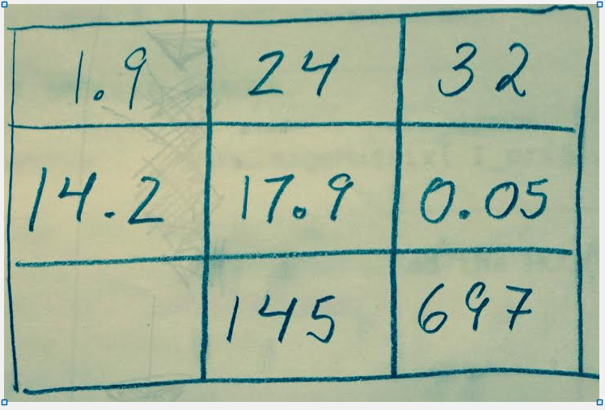
Objectives:
1. Build an open source tool to extract data using crowd-sourcing and machine-learning
2. Test our tool on a heterogeneous set of 139 medical flowsheets, containing ~36K cells of data
3. Work with collaborators to improve the tool
1.9 | 2.4 | 32
14.2 | 17.9 | 0.05
 | 145 | 697

Slide 13
Objectives:
1. Build an open source tool to extract data using crowd-sourcing and machine-learning
2. Test our tool on a heterogeneous set of 139 medical flowsheets, containing ~36K cells of data
3. Work with collaborators to improve the tool
1.9 | 2.4 | 32
14.2 | 17.9 | 0.05
 | 145 | 697
Notes:
flowsheets

Slide 14
Objectives:
1. Build an open source tool to extract data using crowd-sourcing and machine-learning
2. Test our tool on a heterogeneous set of 139 medical flowsheets, containing ~36K cells of data
3. Work with collaborators to improve the tool
1.9 | 2.4 | 32
14.2 | 17.9 | 0.05
 | 145 | 697
Notes:
who are interested

Slide 15
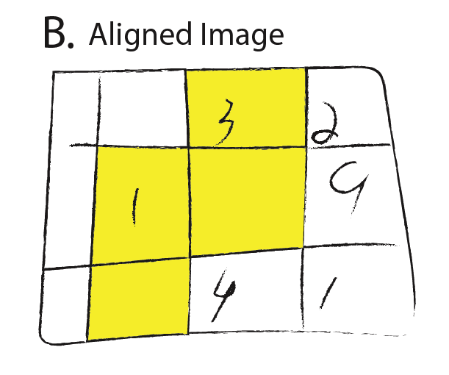
How the Tool Works: 4 Steps
Step 1: the extraction of cell images from the spreadsheet grid
Step 2: machine recognition of digits within the cells
Step 3: human transcription of cells with challenging content
Step 4: feedback of human transcription results to the machine

Slide 16
How the Tool Works: 4 Steps
Step 1: the extraction of cell images from the spreadsheet grid
Step 2: machine recognition of digits within the cells
Step 3: human transcription of cells with challenging content
Step 4: feedback of human transcription results to the machine

Slide 17
The user takes a photo of a spreadsheet they wish to transcribe

Slide 18
The software assumes that images are aligned

Slide 19
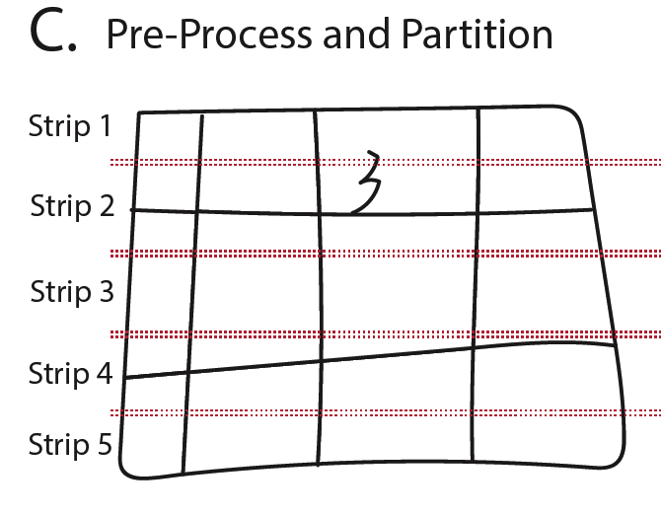
The images are adaptively filtered to remove color and shading
Retain the largest connected component (the gridlines)
Notes:
An illustration of Steps 1-4 of our method. (A) Example of a hand-drawn spreadsheet which we may wish to transcribe. (B) The spreadsheet after manual alignment of the image. (C) Black and white image following preprocessing with image strip lines. (D) Estimation of column number using k-means clustering on Hough transform vertical line peaks (illustrated as red dots). (E) Extraction of candidate points using k-mean centroids with k set according to the estimate. (F) A set of extracted column point candidates. (G) Column splines through the combination of candidate points. (H) Completed column splines. (I) Identification of intersection points between row and column splines. (J) Partitioning of the original image into individual cells.

Slide 20
The image is then cut into strips

Slide 21
Within a given strip, the Hough image transform is applied to identify the location of near vertical line segments

Slide 22
The number of spreadsheet columns are estimated based on the number of Hough peak clusters
Notes:
Estimation of column number using k-means clustering on Hough transform vertical line peaks (illustrated as red dots).

Slide 23
K-mediods is applied to the Hough peaks to identify the location of the column-lines, within the strip

Slide 24
This process is repeated for all strips

Slide 25
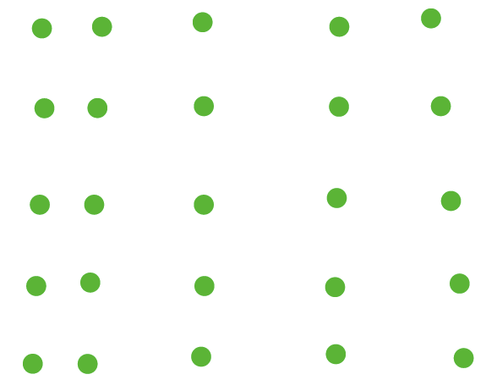
This leaves us with a set of points that represent the location of the line within each strip

Slide 26
This leaves us with a set of points that represent the location of the line within each strip

Slide 27
Starting from the center-most strip

Slide 28
We identify the closest neighboring points above, and below, within a search window

Slide 29
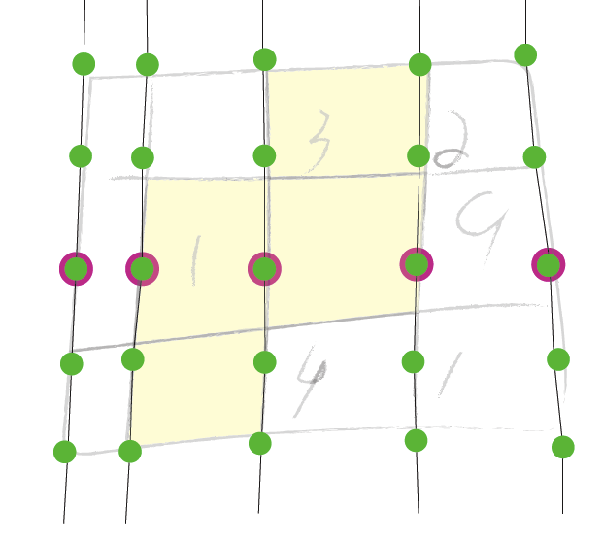
This allows us to approximate the location of the column lines

Slide 30
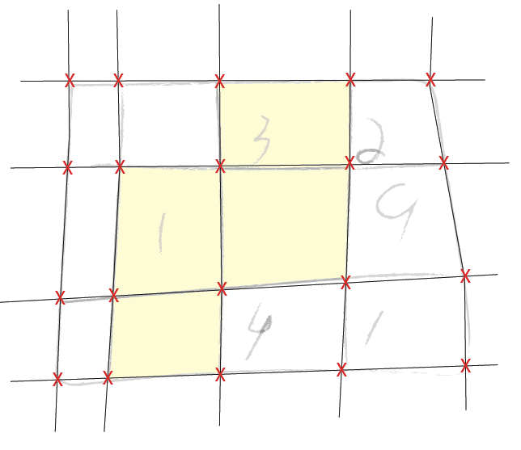
The same process may be performed to estimate the location of the row lines
The intersection of the row and column lines identify the borders of each cell image

Slide 31
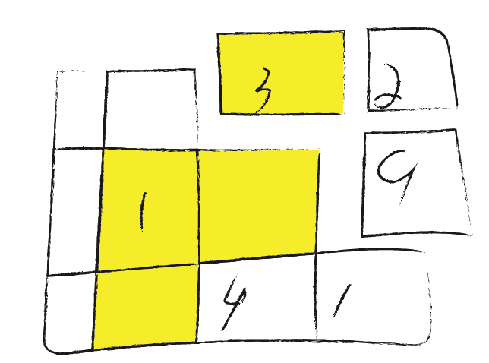
Allowing us to extract the images, for further processing

Slide 32
How the Tool Works: 4 Steps
Step 1: the extraction of cell images from the spreadsheet grid
Step 2: machine recognition of digits within the cells
Step 3: human transcription of cells with challenging content
Step 4: feedback of human transcription results to the machine

Slide 33
How the Tool Works: 4 Steps
Step 1: the extraction of cell images from the spreadsheet grid
Step 2: machine recognition of digits within the cells
Step 3: human transcription of cells with challenging content
Step 4: feedback of human transcription results to the machine

Slide 34
How the Tool Works: 4 Steps
Step 1: the extraction of cell images from the spreadsheet grid
Step 2: machine recognition of digits within the cells
Step 3: human transcription of cells with challenging content
Step 4: feedback of human transcription results to the machine
?
?

Slide 35
Digit Extraction
Once the cells are extracted, we classify their contents

Slide 36
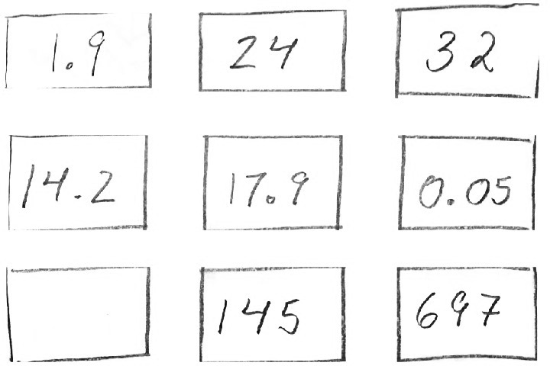
Digit Extraction
To do this, we extract digits from the cells

Slide 37
Digit Extraction
Digits are extracted to be uniformly sized, so they are compatible with popular machine learning approaches

Slide 38
Digit Extraction
Digits are extracted to be uniformly sized, so they are compatible with popular machine learning approaches

Slide 39
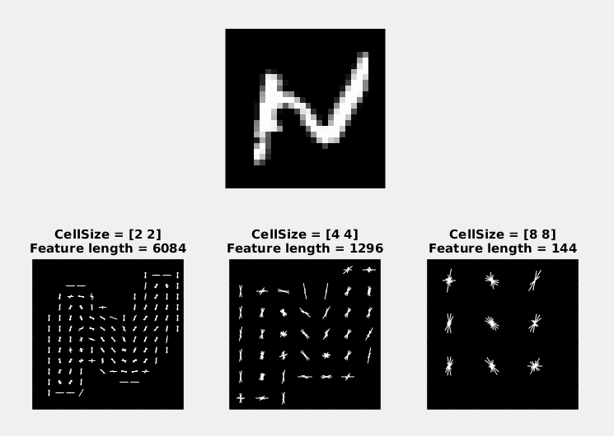
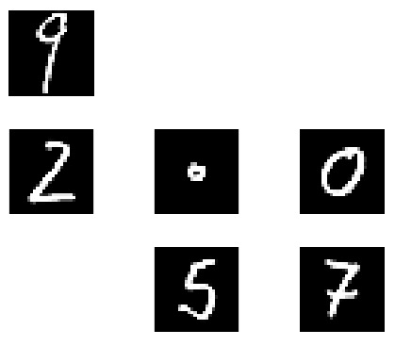
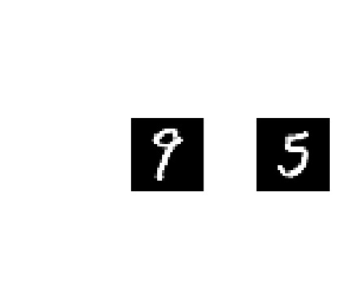
Digit Classification
After digits are extracted, we deploy a Multinomial Support Vector Machine with histogram of oriented gradient features (HoG) for classification

Slide 40
Digit Classification
Confusion matrix
The algorithm was trained using the MNIST dataset
Performance was within 2% of state-of-the-art ‘deep networks’

Slide 41
Digit Classification
The algorithm classifies digits, according to their multinomial probability

Slide 42
Digit Classification
99%
For some digits, it will have high confidence

Slide 43
Digit Classification
30%
For other digits, it will have low confidence

Slide 44
Digit Classification
Cells containing digits above the confidence threshold are transcribed by the machine

Slide 45
How the Tool Works: 4 Steps
Step 1: the extraction of cell images from the spreadsheet grid
Step 2: machine recognition of digits within the cells
Step 3: human transcription of cells with challenging content
Step 4: feedback of human transcription results to the machine
?
?

Slide 46
How the Tool Works: 4 Steps
3
2
Step 1: the extraction of cell images from the spreadsheet grid
Step 2: machine recognition of digits within the cells
Step 3: human transcription of cells with challenging content
Step 4: feedback of human transcription results to the machine
1
?
1
?

Slide 47
How the Tool Works: 4 Steps
3
2
Step 1: the extraction of cell images from the spreadsheet grid
Step 2: machine recognition of digits within the cells
Step 3: human transcription of cells with challenging content
Step 4: feedback of human transcription results to the machine
1
?
1
?

Slide 48
Human Transcription
Cells that contained digits beneath a confidence threshold are marked for the crowd annotation

Slide 49
Human Transcription
By doing crowd annotation one cell at a time, patient privacy is protected!

Slide 50
Mechanical Turk Worker Transcription Costs
There were an average of 11 workers performing the transcription task in parallel at any given time.
The average time from acceptance of the task to submission of the transcribed cell image was 7.24 seconds
We offered a total payment of $0.01 per cell (an equivalent of $4.97 per hour of labor).

Slide 51
Clinical Research Assistant Transcription Costs
The median hourly wage of a clinical research assistant in the United States is $22.15.
We estimated the average rate of cell transcription for a certified research assistant by manually transcribing a full 10x10 spreadsheet image into a corresponding CSV file.
The total time for spreadsheet transcription was 12.5 minuets, providing an estimated transcription rate of 7.5 seconds per cell.

Slide 52
How the Tool Works: 4 Steps
3
2
Step 1: the extraction of cell images from the spreadsheet grid
Step 2: machine recognition of digits within the cells
Step 3: human transcription of cells with challenging content
Step 4: feedback of human transcription results to the machine
1
?
1
?

Slide 53
How the Tool Works: 4 Steps
3
2
Step 1: the extraction of cell images from the spreadsheet grid
Step 2: machine recognition of digits within the cells
Step 3: human transcription of cells with challenging content
Step 4: feedback of human transcription results to the machine
1
4
1
9

Slide 54
How the Tool Works: 4 Steps
Step 1: the extraction of cell images from the spreadsheet grid
Step 2: machine recognition of digits within the cells
Step 3: human transcription of cells with challenging content
Step 4: feedback of human transcription results to the machine
4
9

Slide 55
Digit Classification
The algorithm is then retrained using the new annotations from the crowd workers

Slide 56
Key Results + Cost Comparison

Slide 57
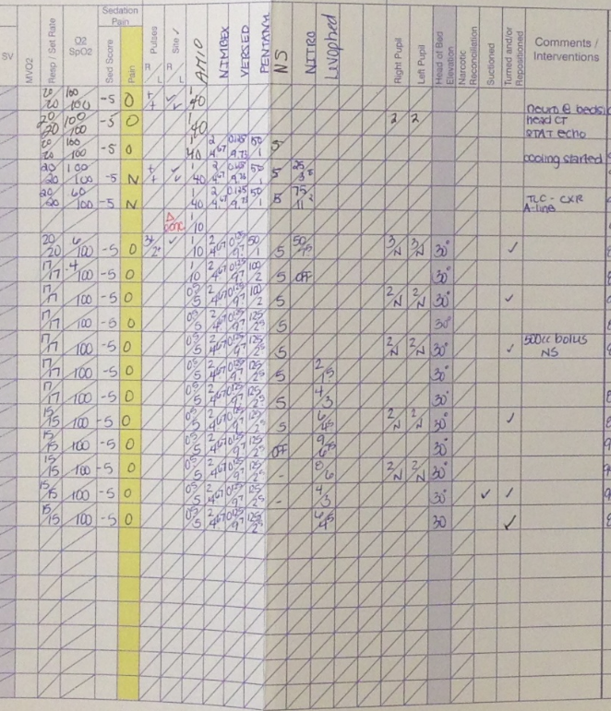
Grid Line Extraction
an example of a spreadsheet image transcribed by the software

Slide 58
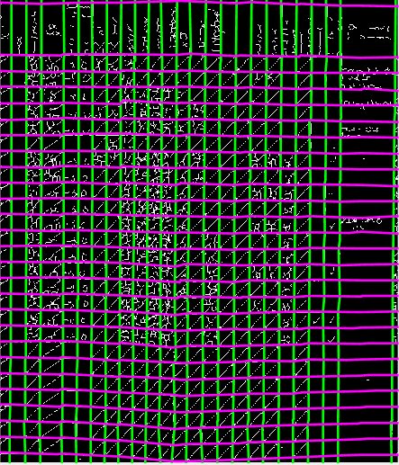
Grid Line Extraction
The grid-line extraction accounts for non-uniformities in: lighting, bends in paper, cell size, etc
In our collected data, 93% of grid lines were accurately idetified

Slide 59
At a digit confidence threshold of 99%, cell contents are correctly classified in 90% of cases
Our tool was half the price and 11.4 times faster than a clinical research assistant
A lower bound for savings using this approach is 5.6%
Notes:
After crown feedback, the tool’s classification performance improved further
At the 80% confidence threshold, we observed a 10% improvement in accuracy
The lower bound for savings using this approach was 10%

Slide 60
After crowd feedback, the tool’s classification performance improved further
At the 80% confidence threshold, we observed a 10% improvement in accuracy
The lower bound for savings using this approach was 10%
Notes:
After crown feedback, the tool’s classification performance improved further
At the 80% confidence threshold, we observed a 10% improvement in accuracy
The lower bound for savings using this approach was 10%

Slide 61
For code, collaborations and the full paper:
http://ghassemi.xyz

